Slide 1
LC-3 Hardware and Instructions

Slide 2
Instructions
An instruction has two parts:
opcode : The operation being performed.
These are divided into three categories: Operate, Data Movement, and Control
LC3 has 15 opcodes (ADD, AND, BR, JMP, JSR, JSRR, LD, LDI, LDR, LEA, NOT, RET, RTI, ST, STI, STR, TRAP)
operands : The data to use in the operation.
This data is read from somewhere as specified by the instruction and the addressing mode
LC3 has 5 addressing modes (Immediate, Register, PC-Relative, Indirect, Base+Offset)

Slide 3
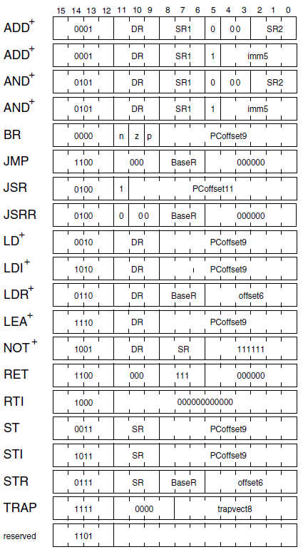
Format for all LC3 Instructions
See appendix A

Slide 4
Opcode Summary
Add - ADD value in a register to a value in a register. Store result in a register.
Add - ADD value in a register to a number. Store result in a register.
And - Bitwise AND value in a register to a value in a register. Store result in a register.
And - Bitwise AND value in a register to a number. Store result in a register.
Not – Invert all of the bits in a register and store the result in a register.
BR, BRNZP – Conditional branch. Like if statement.
LD, LDR, LDI – Load register with a value from memory
ST, STR, STI – Store register value somewhere in memory.
LEA – Load an address into a register and not the data.
JMP – Jump execution to some other place in memory.
JSR, JSRR – Jump to a subroutine similar to a function or method.
RET – Return from the subroutine
RTI – Return from interrupt, restores process information.
TRAP – System call. Like an operating system. Handles input and output.

Slide 5
Data Types and Condition Codes
An ISA can have different data types.
LC3 uses 2's complement numbers
Condition codes are special flags that get set when certain operations occur.
LC3 uses N, P, and Z
N – is set if the result of an operation is negative.
P – is set if the result of an operation is positive (redundant?).
Z – is set if the result of an operation is zero.
Other common flags (that are not in the LC3)
C – the result of the carry out of an add operation
v – set in the even of an overflow condition

Slide 6
Registers
Eight general purpose registers (R0 – R7).
Instruction Register (IR)– Holds the instruction in the microprocessor so it can be interpreted.
Program Counter (PC) – Holds the address of the next program step. Looping is accomplished by changing the value of the PC.
Memory Address Register (MAR) – When transferring to/from memory, this will hold the address of the memory unit to be written or read.
Memory Data Register (MDR) – When transferring to memory, this holds the value to save. When transferring from memory, this holds the value read.
KeyBoard Data Register (KBDR) – Holds the ASCII character of the key after it has been typed.
KeyBoard Status Register (KBSR) – Status information that lets the microprocessor know a key has been typed and is ready to be read.
Display Data Register (DDR) – Holds the ASCII character to display on the screen.
Display Status Register (DSR) – Status information. Use this to tell the display you are ready to write the character from the DDR to the screen.
Process State Register (PSR) – Information about the current state of the current program.

Slide 7
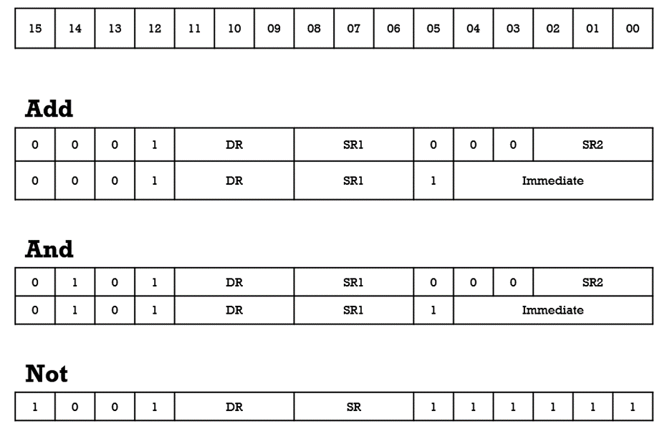
Operate Instructions formats
On LC3 all operate instructions (ADD, AND, and NOT) use register or immediate addressing mode.

Slide 8
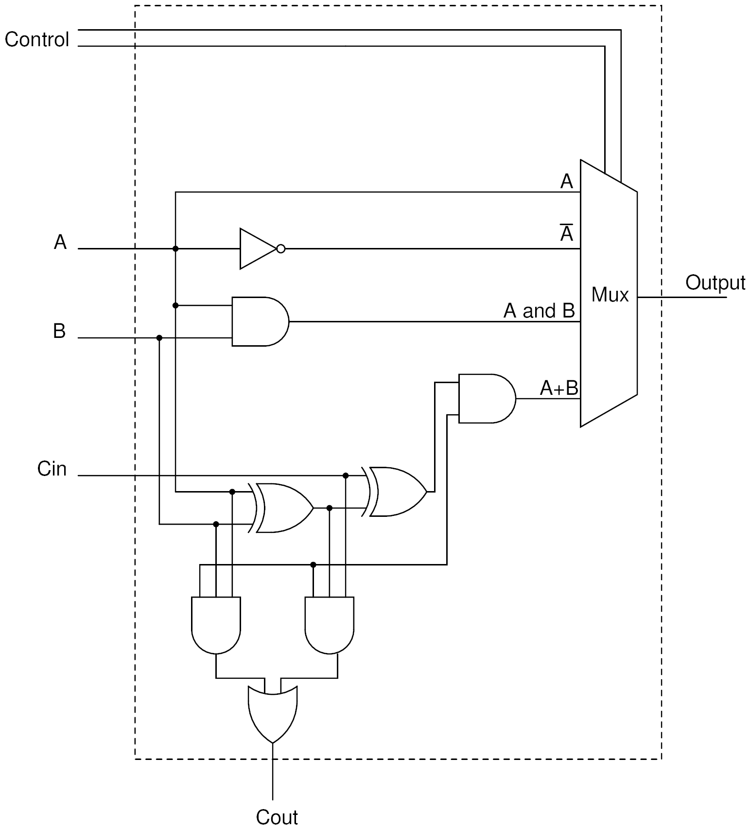
ALU

Slide 9
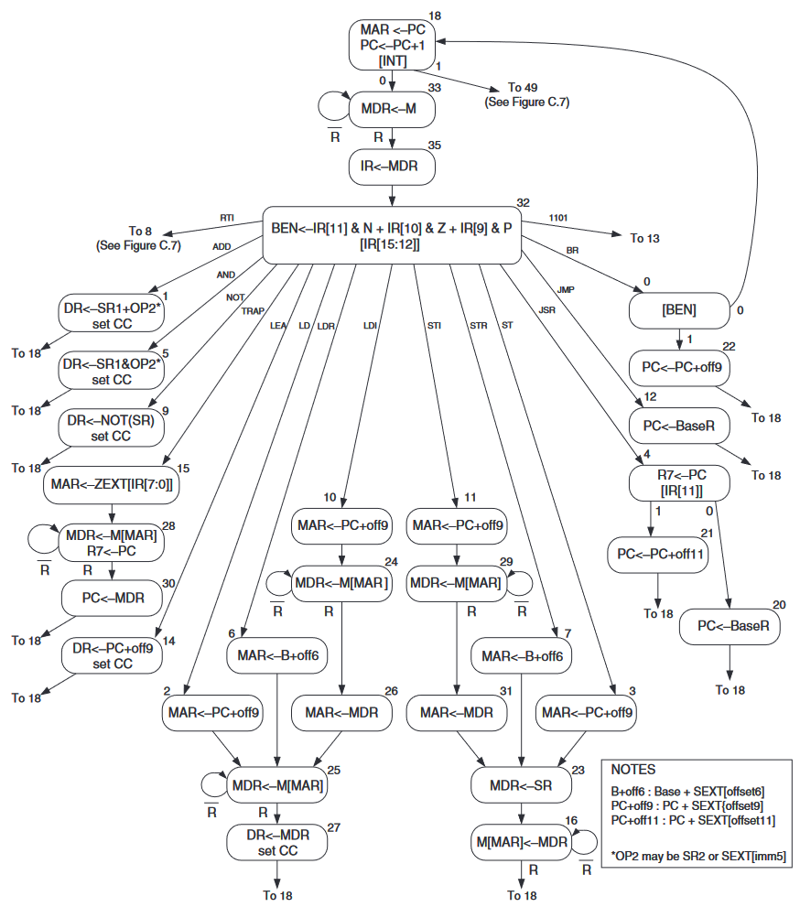
LC3 State Diagram

Slide 10
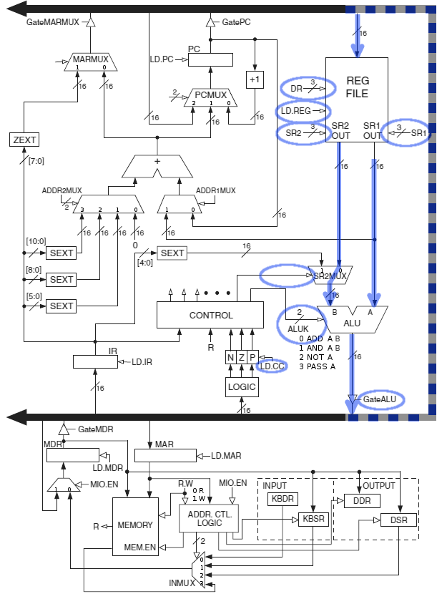
Hardware – Add Register
0001010011000000
0001 010 011 0 00 000
R2<-R3 + R0 (1 clock cycle)
Similar to figure 5.5 in book

Slide 11
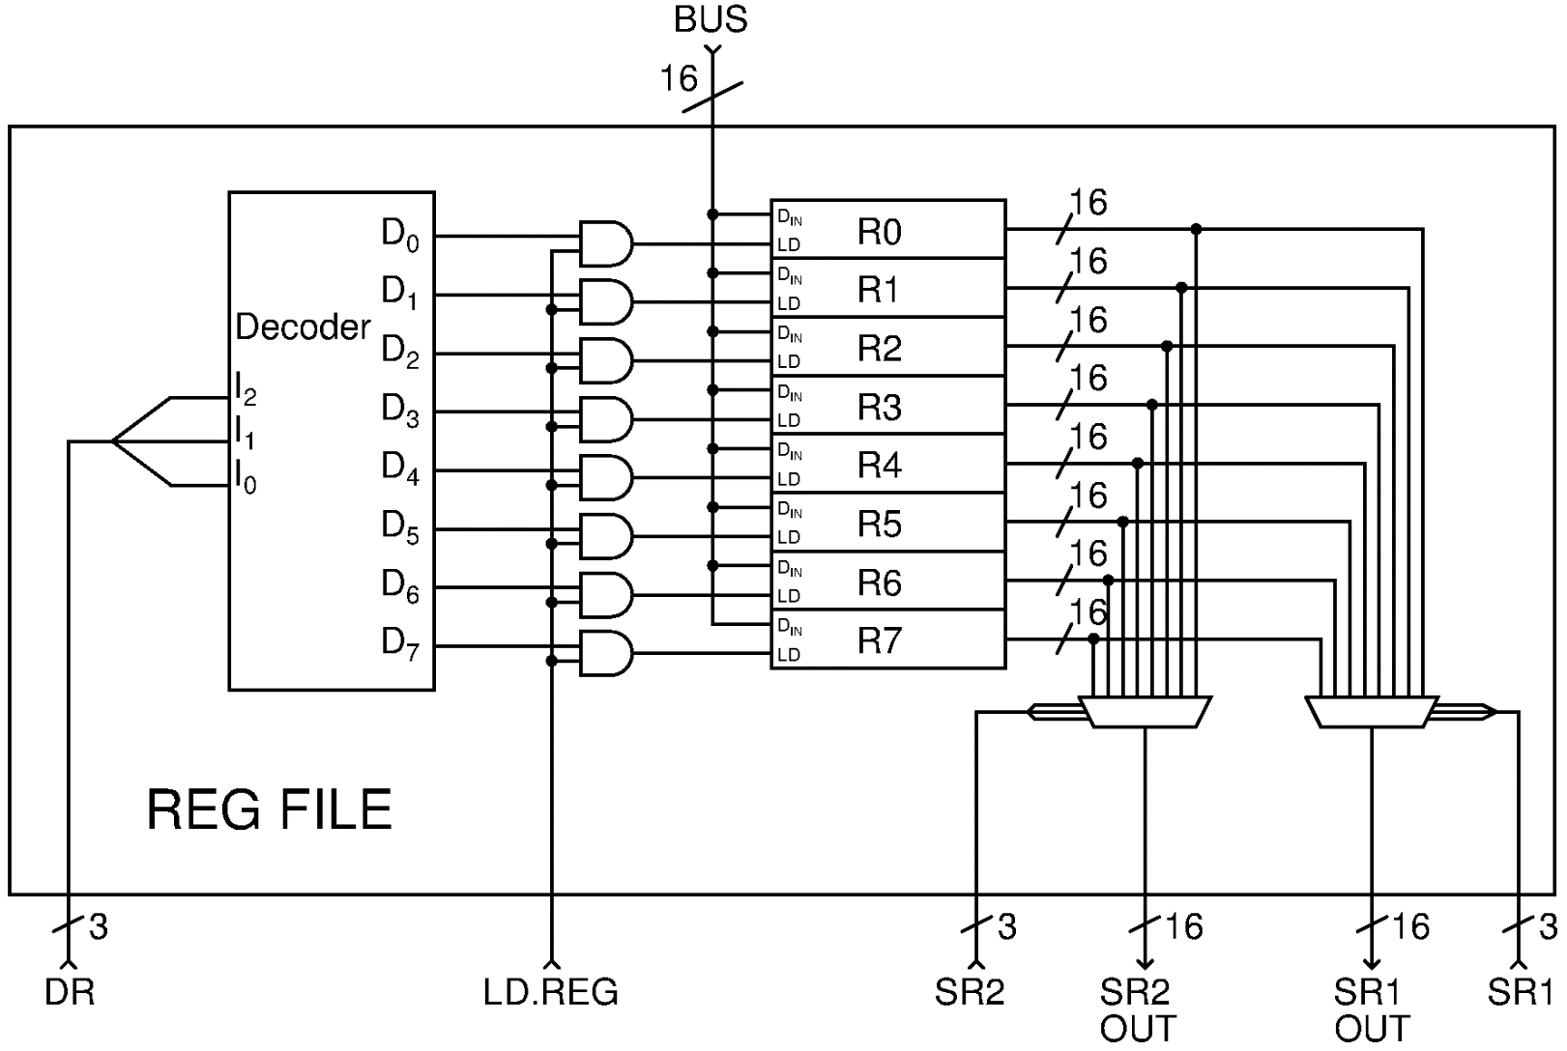
REG FILE – general purpose register storage and control

Slide 12
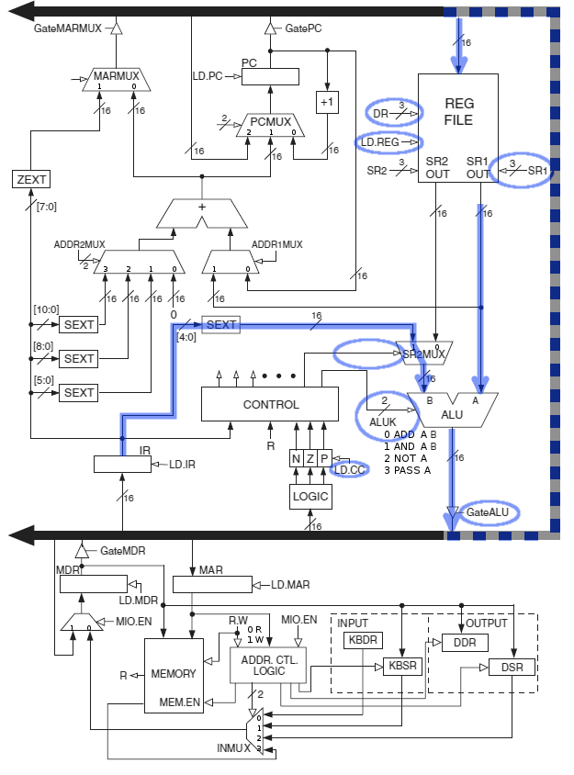
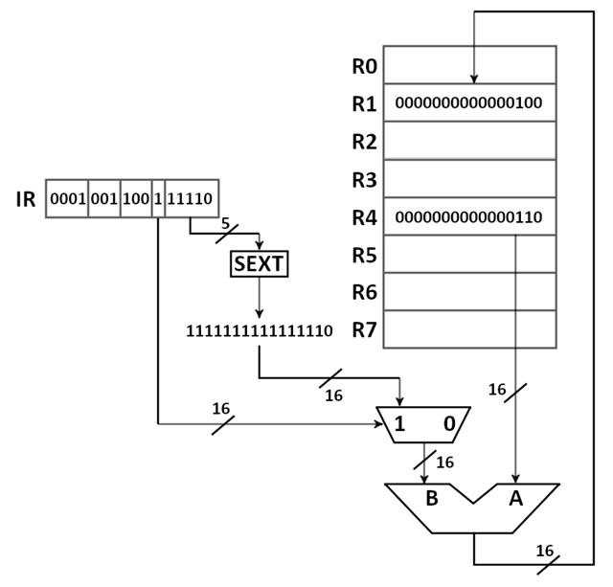
Hardware – Add Immediate
0001010011111101
0001 001 100 1 11110
R1<-R5 + -2 (1 clock cycle)
Figure 5.5 in book below

Slide 13
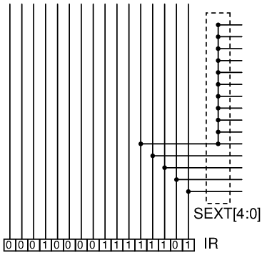
Sign Extension
What is the value of the immediate operand?

Slide 14
Operate Instructions
With only ADD, AND, NOT…
R1 = 5, R2 = 3, R3 = 0
Perform the following (write the code in hex)
R1 <- R2 – R1 (Subtraction)
R1 <- R2 | R1 (Bitwise or)
R1 <- R2 (Transfer)
R1 <- 0 (Clear)

Slide 15
Data Movement Instructions
Moving data from
Register to memory
Memory to register
(Register to register is covered under operate instructions)
Addressing modes
Immediate
PC-Relative
Indirect
Base + offset

Slide 16
PC Relative – LD & ST
Uses the current value of the program counter
Adds a value specified in the instruction.
LD – Load value from memory and place it into a register.
ST – Stores register value in memory.
4-bit opcode, 3-bit register, 9-bit value
Value is 9-bit 2's compliment (Range?)
Effective address – The ACTUAL address of the operand. This is the value after all calculations and redirections have been made.

Slide 17
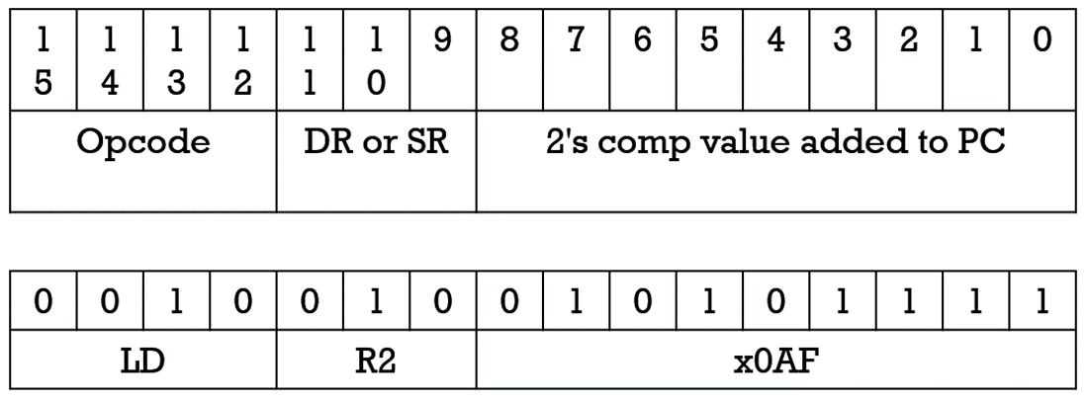
LD/ST Relative Format
LD – Load value from memory and place it into a register.
ST – Save value from register to memory
Load what is stored in memory location PC + x0AF into R2
Assume this LD is stored at x3000, what is the effective address?

Slide 18
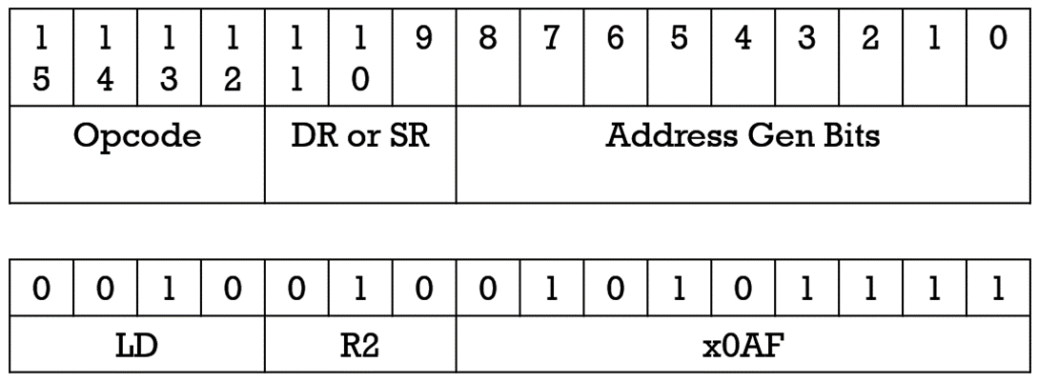
LD format EXAMPLE
LD – Load value from memory and place it into a register.
Assume this LD is stored at x3000, what is the effective address? x30B0
Remember the PC is incremented after loading the instruction.
Assume x0035 is stored at memory location x30B0.

Slide 19
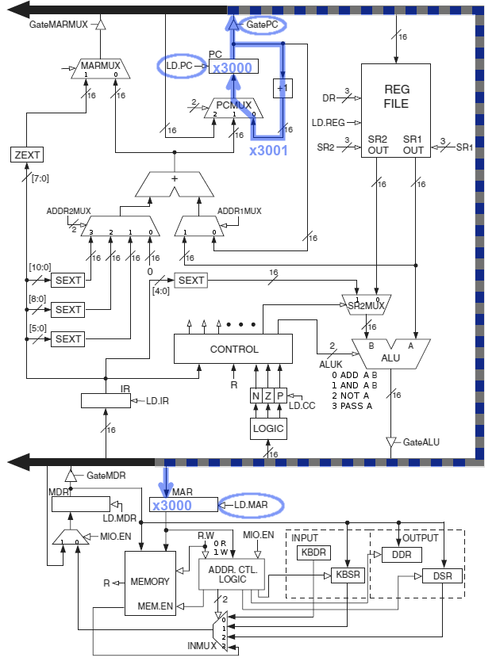
Example Fetch next instruction Fetch step 1 State 18
First step.
MAR<-PC
(MAR gets PC value)
PC<-PC+1
(PC gets PC value +1)
Assuming x3000 is the original value in the PC.

Slide 20
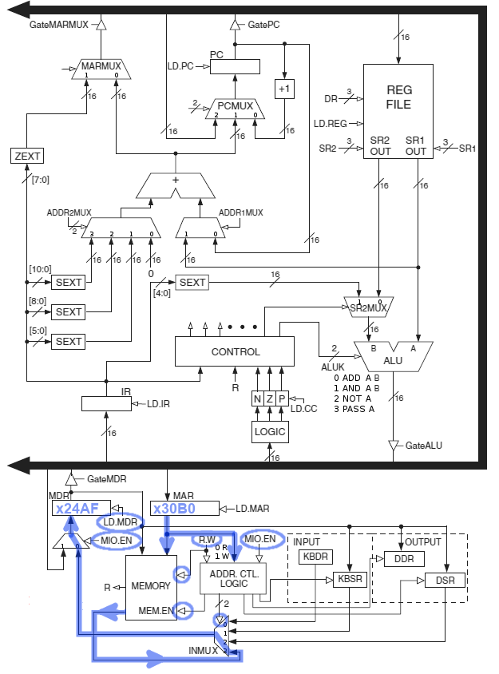
Example fetch next instruction fetch step 2 State 33
Second step.
MDR<-MEM[MAR]
(MDR gets memory value an MAR)
Assuming value x24AF is stored in memory location 3000.

Slide 21
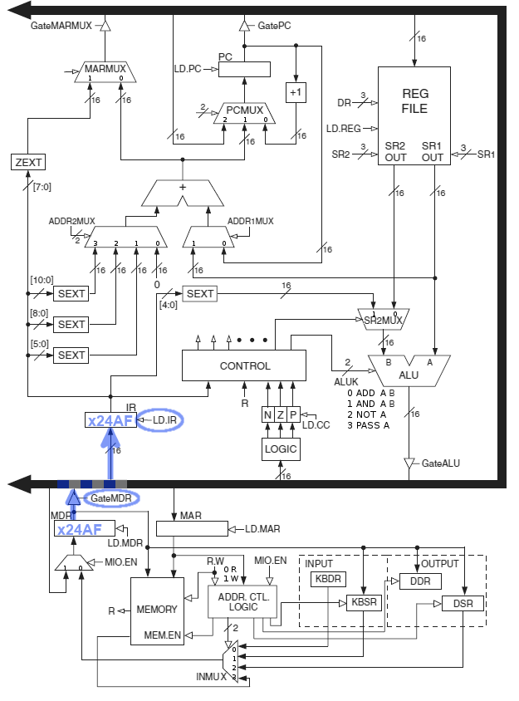
Example Fetch next instruction fetch step 3 state 35
Third step.
IR<-MDR
(IR gets MDR)
The third step moves the instruction from the MDR to the bus and the IR reads what is on the bus.

Slide 22
LD Example
24AF
0010 0100 1010 1111
LD R2, #xAF
How do we calculate the effective address?
PC + PC_OFFSET
This instruction must do the following
Get the PC
Get the bottom 9 bits of the IR
Add the two above values
Put that value in the MAR
Look up MAR in memory and move value to MDR
Get the value from the MDR and put it into R2
MAR<-PC+IR[8:0]
MDR<-MEM[MAR]
R2<-MDR

Slide 23
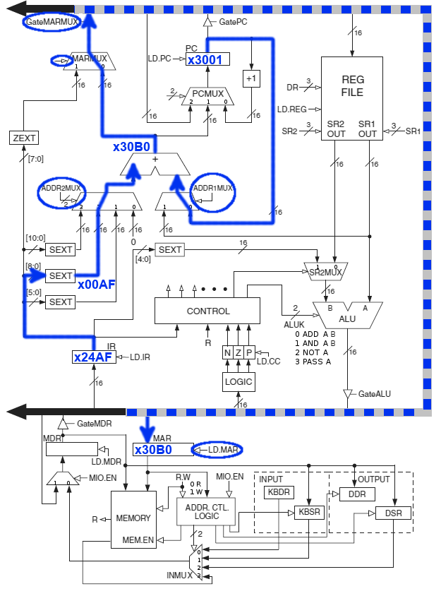
Example instruction LD R2, #aF Execute step 1 STATE 2
( The fourth step is sort of an extra step not shown in hardware that checks to see if a branch should occur. Set BEN or Branch Enable Bit.)
Fifth Step. Shown on diagram
MAR<-PC + IR[8:0]
(IR gets PC + lower 8 bits of IR)
Calculate the address of the operand and move to MAR.

Slide 24
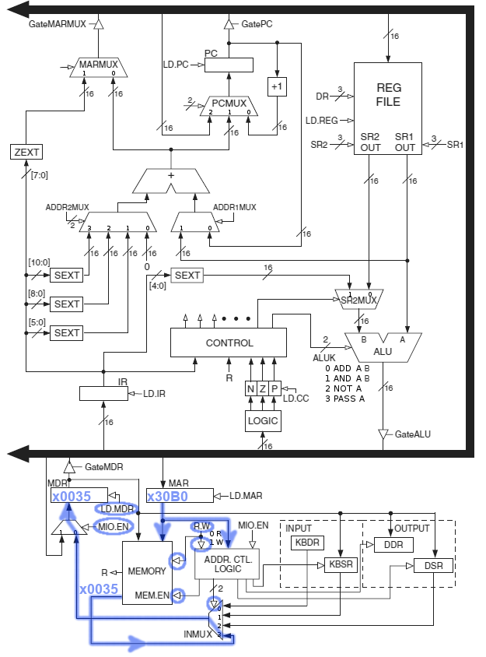
Example instruction LD R2, #aF Execute step 2 State 25
Sixth Step.
MDR<-M[MAR]
(MDR gets the data stored in the address that is in MAR.)
Move the data from memory to the MDR.

Slide 25
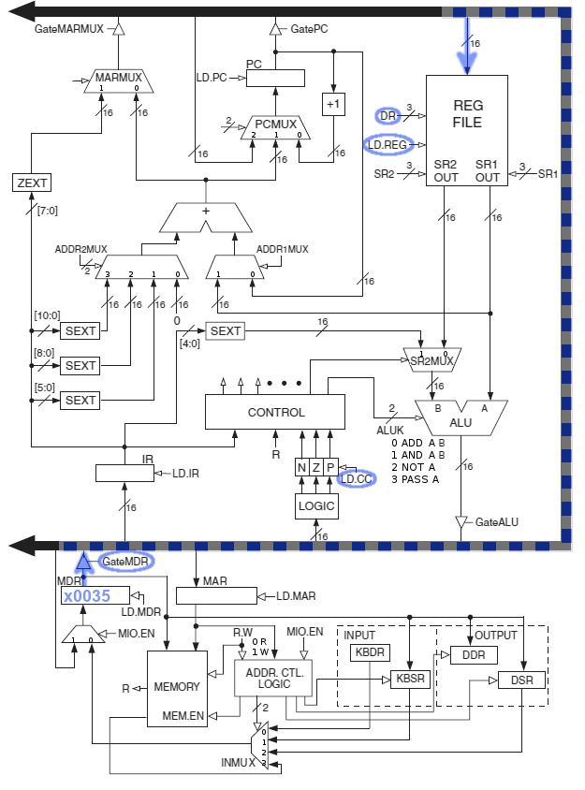
Example instruction LD R2, #aF Execute step 3 State 27
Seventh Step.
DR<-MDR
(DR gets MDR)
Move the data from MDR to the specified register.
Execution of this LD is complete.
Start over with fetch of the next instruction.

Slide 26
ST Example
The order of things are a little different in a store.
With LD we put an address into the MAR and the data appears in the MDR.
With ST we must put an address into the MAR then put the data to be stored into the MDR.
THEN we can write to memory.

Slide 27
Example instruction ST R2, #aF Execute step 1 STATE 3
Same as state 2 in the LD instruction.
MAR<-PC + IR[8:0]
(IR gets PC + lower 8 bits of IR)
Calculate the address of the operand and move to MAR.

Slide 28
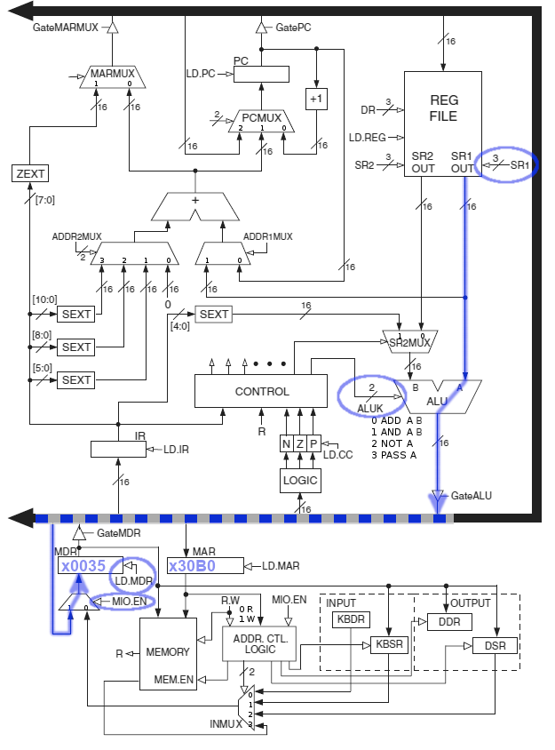
Example instruction ST R2, #aF Execute step 2 STATE 23
Same as state 2 in the LD instruction.
MDR<-SR
Move data for storage into MDR.
Assume x0035 is currently in R2.

Slide 29
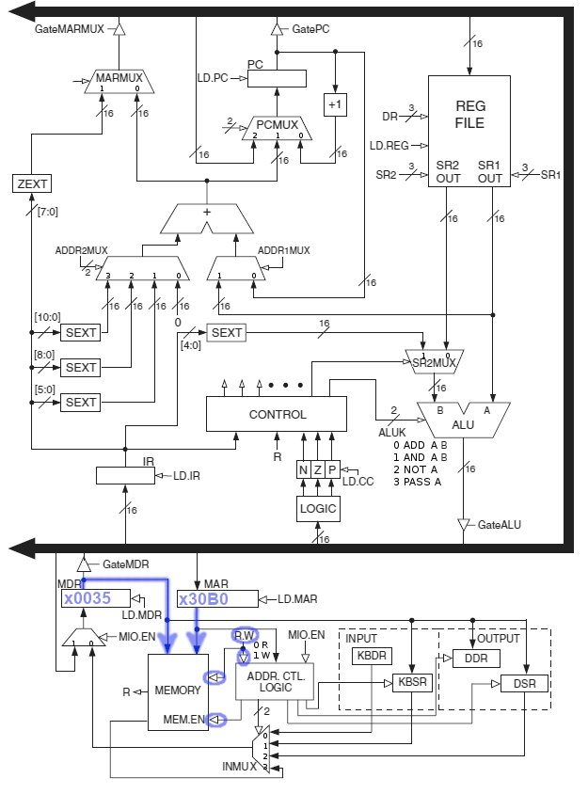
Example instruction ST R2, #aF Execute step 3 STATE 16
Same as state 2 in the LD instruction.
M[MAR]<-MDR
Store MDR to memory.

Slide 30
Indirect Addressing
LDI – Load Indirect – Memory to Register
STI – Store Indirect – Register to Memory
LDI and STI are very similar to LD and ST.
Memory calculation for operand is that same, however, the address calculated is NOT actually the operand.
The address calculated is the address of the operand. (TRICKY)
Indirect has one extra step and needs an extra memory access to get the operand.

Slide 31
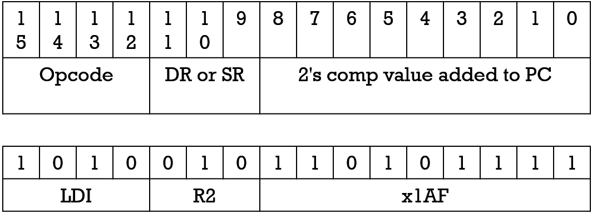
Load Indirect
LDI – Load value from memory and use it as the address of the actual data to move into a register.
MAR <- PC + x1AF
MDR <- MEM[MAR]
MAR <- MDR
R2 <- MEM[MAR]

Slide 32
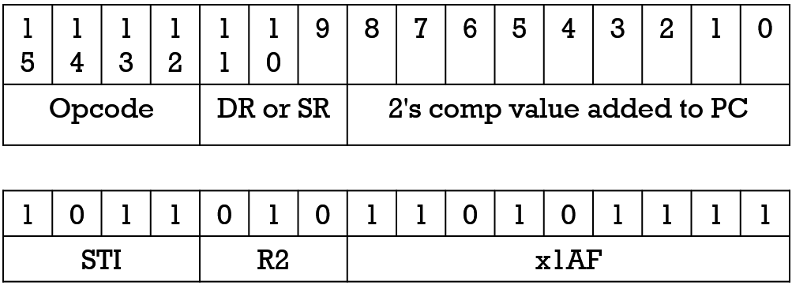
Store Indirect
STI – Save value from register to address specified in memory location.
MAR <- PC + x1AF
MDR <- MEM[MAR] (Can this be done in one cycle?)
MAR <- MDR
MDR <- R2
MEM[MAR] <- MDR

Slide 33
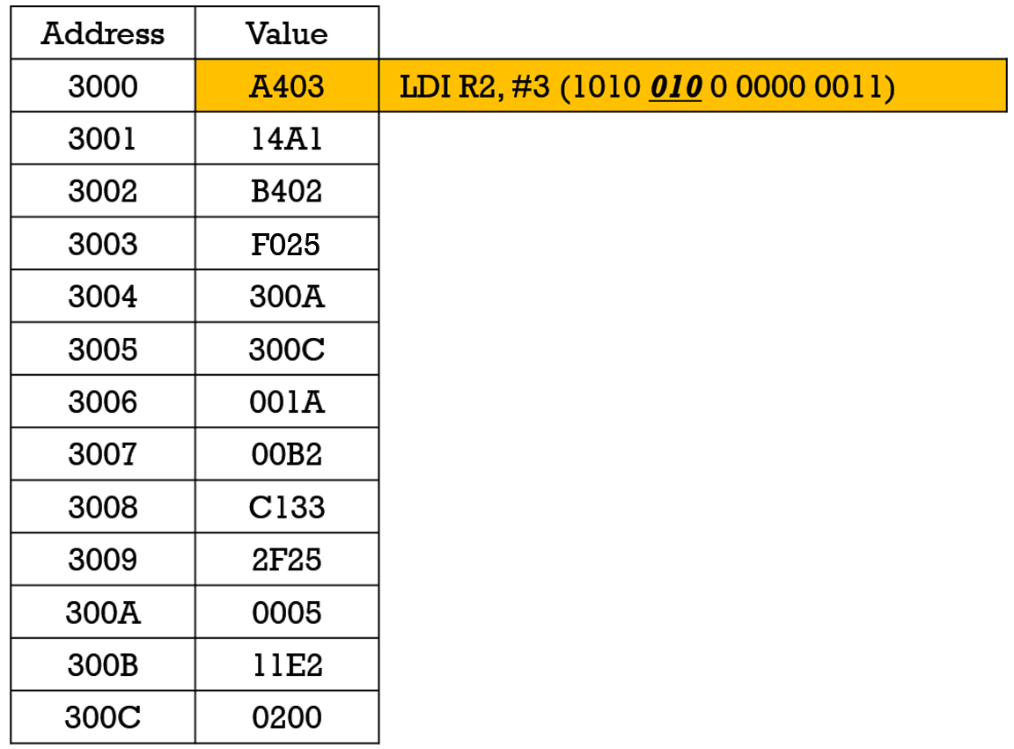
LDI/STI Example step 1
The address is PC + 3 = 3001 + 3 = 3004
What is in address 3004?

Slide 34
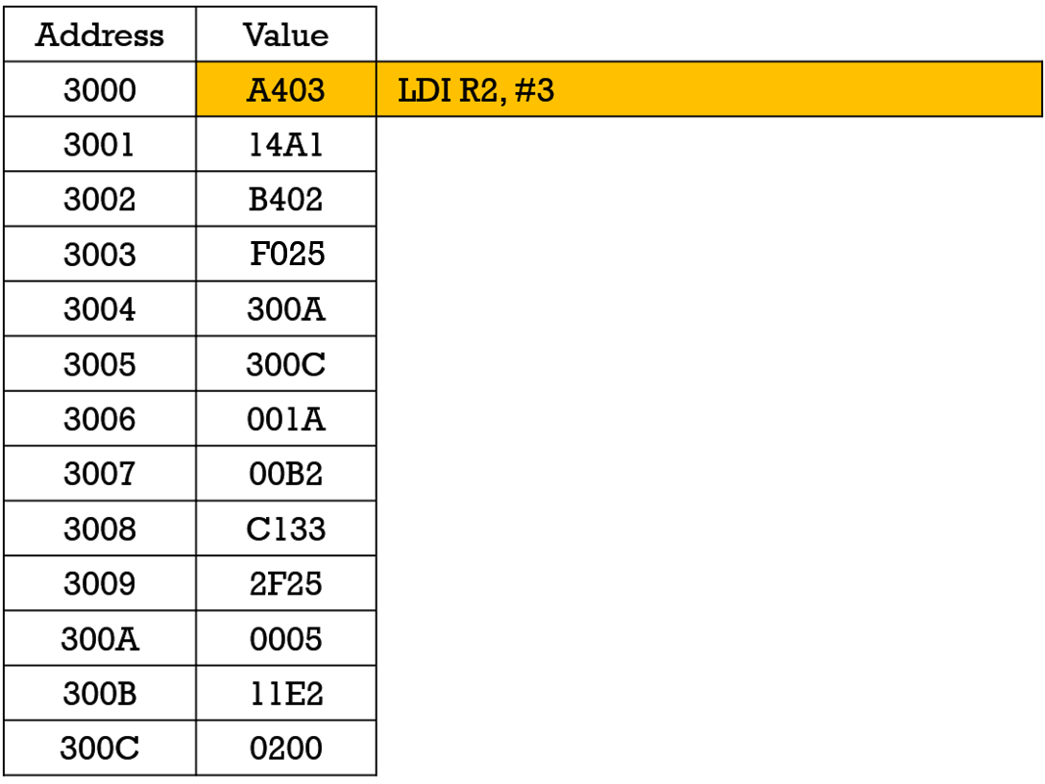
LDI Example step 1 – Effective address
The address is PC + 3 = 3001 + 3 = 3004
What is in address 3004? 300A
300A is the Effective Address
The operand is stored in 300A
What is in address 300A?

Slide 35
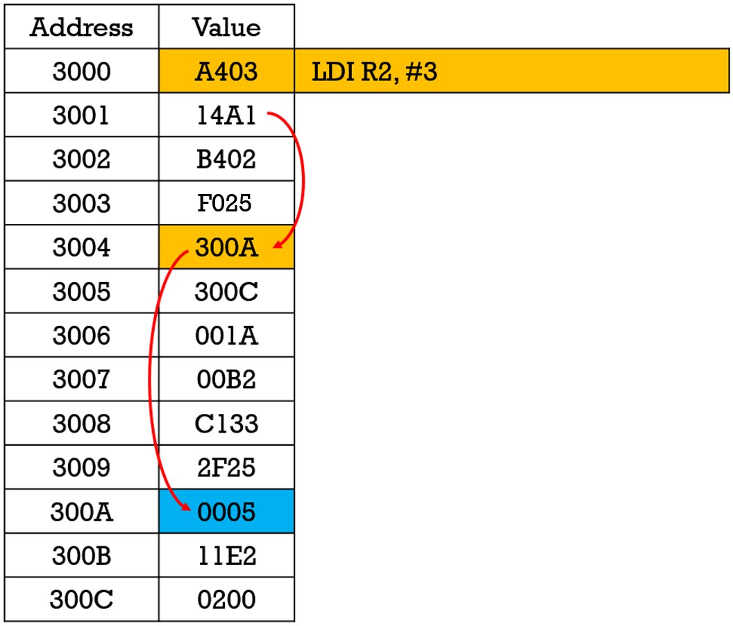
LDI Example step 1 – DATA
The address is PC + 3 = 3001 + 3 = 3004
What is in address 3004? 300A
300A is the Effective Address.
The operand is stored in 300A.
What is in address 300A? 5
R2 will be loaded with 5.

Slide 36
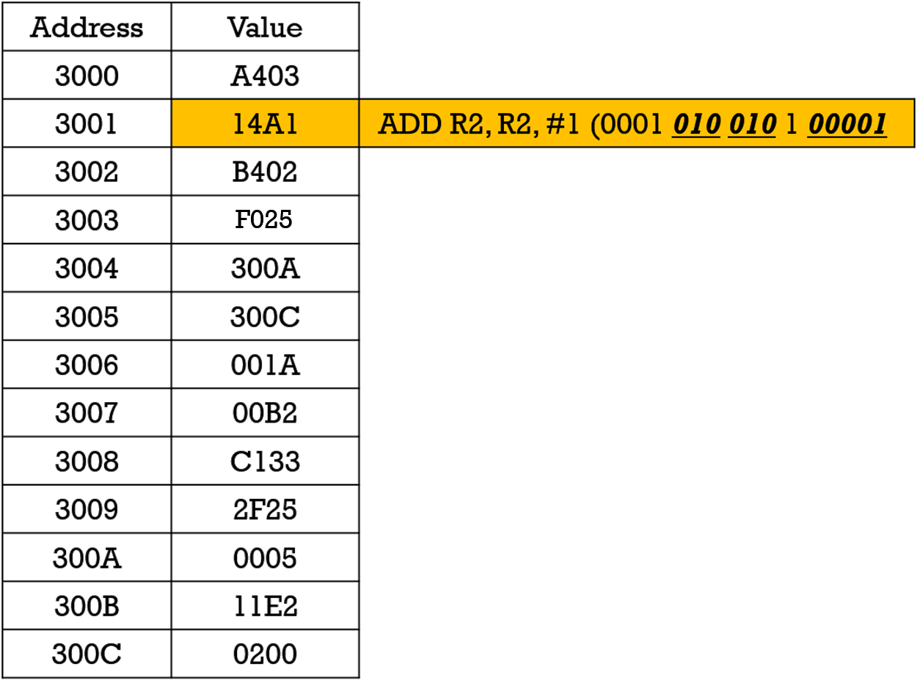
Add example
R2 <- R2 + 1

Slide 37
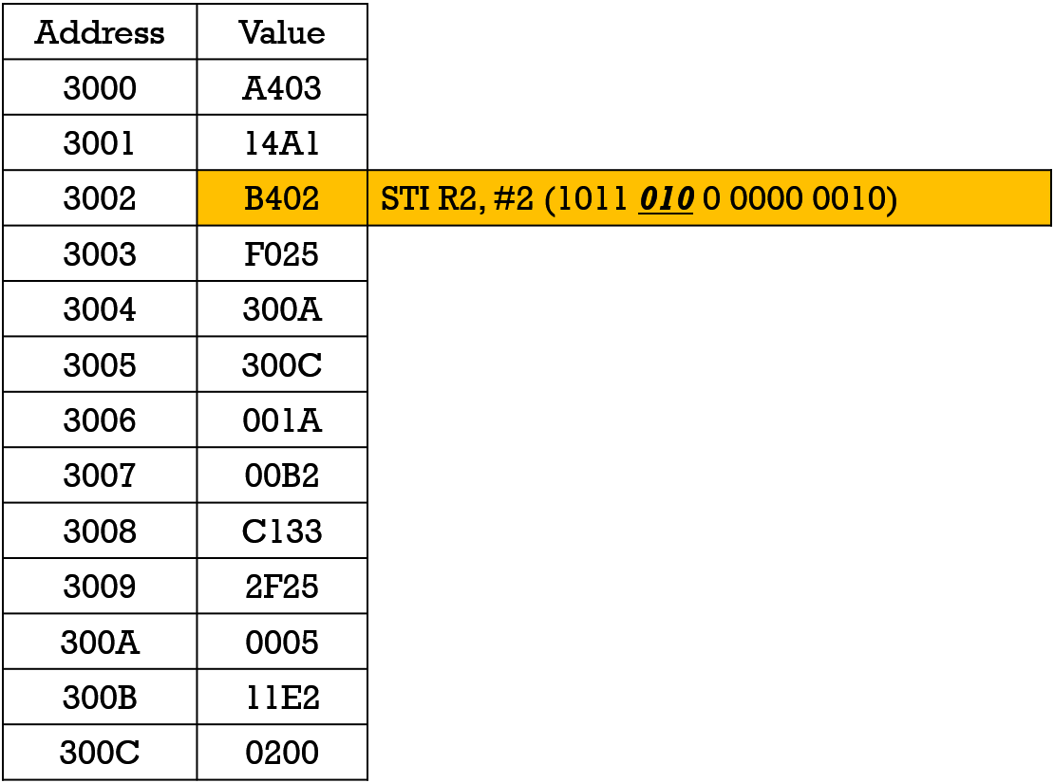
STI Example step 1 – Effective address
Store R2 somewhere.
What is the address from the instruction?
What is the effective address?
What gets stored where?

Slide 38
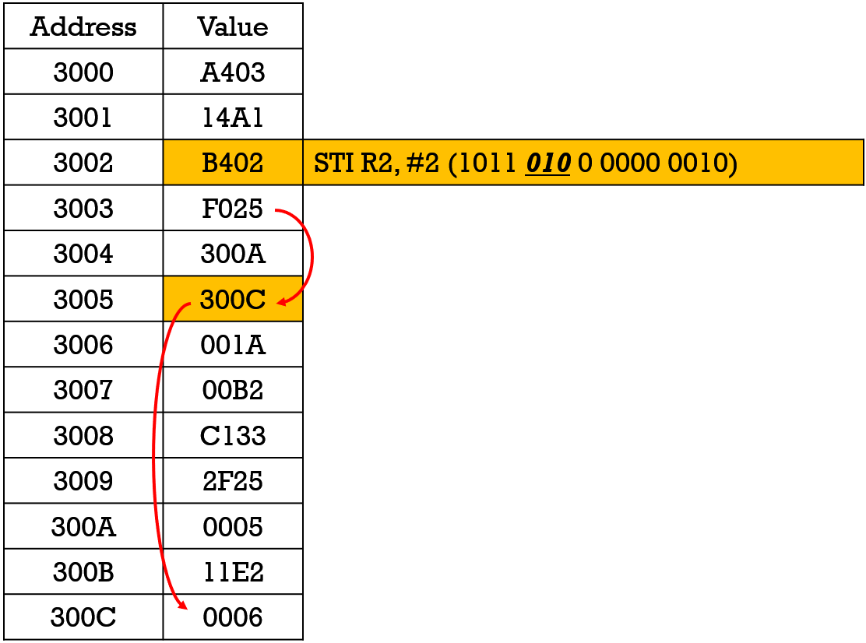
STI Example step 2 – DATA
Store R2 somewhere.
What is the address from the instruction?
3003 + 2 = 3005
What is the effective address?
300C
What gets stored where?
MEM[300C] <- 6

Slide 39
Compare LD and LDI
 | LD | LDI
Fetch Instruction 1 | MAR <- PC, PC <- PC+1 | MAR <- PC, PC <- PC+1
Fetch Instruction 2 | MDR <- MEM[MAR] | MDR <- MEM[MAR]
Fetch Instruction 3 | IR <- MDR | IR <- MDR
Fetch Operand 1 | MAR <- PC + IR[8:0] | MAR <- PC + IR[8:0]
Fetch Operand 2 | MDR <- MEM[MAR] | MDR <- MEM[MAR]
Fetch Operand 3 | R2 <- MDR | MAR <- MDR
Fetch Operand 4 |  | MDR <- MEM[MAR]
Fetch Operand 5 |  | R2 <- MDR

Slide 40
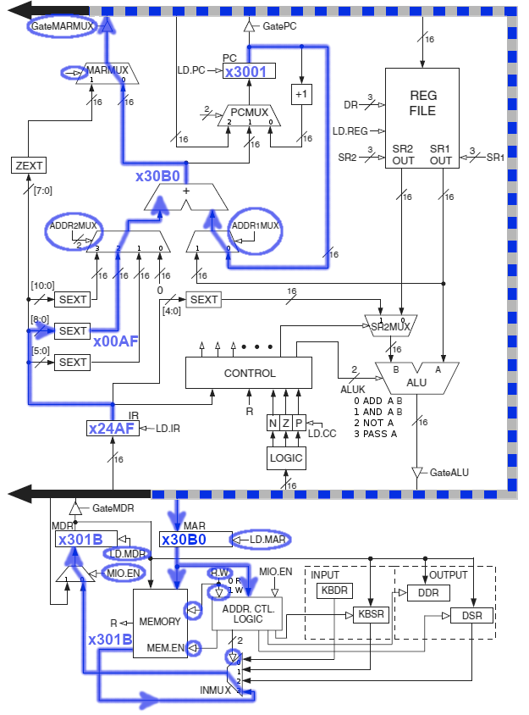
Example instruction LDI R2, #AF Execute steps 1 & 2 STATE 10 & 24
Both execution step 1 and step 2 are shown.
Assume LDI is in memory location x3000 and value x301B is stored at location x30B0
Step 1
MAR <- PC + IR[8:0]
Step 2
MDR <- MEM[MAR]

Slide 41
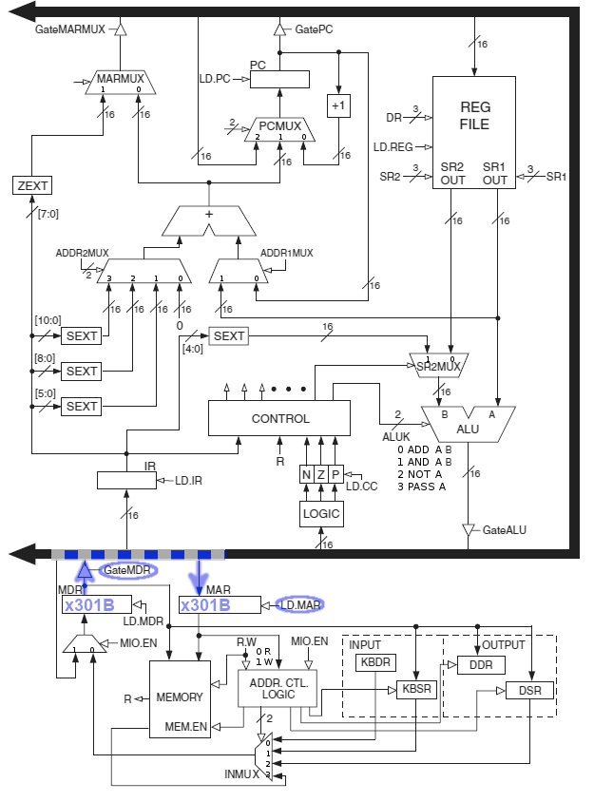
Example instruction LDI R2, #AF Execute Step 3 State 26
MAR <- MDR

Slide 42
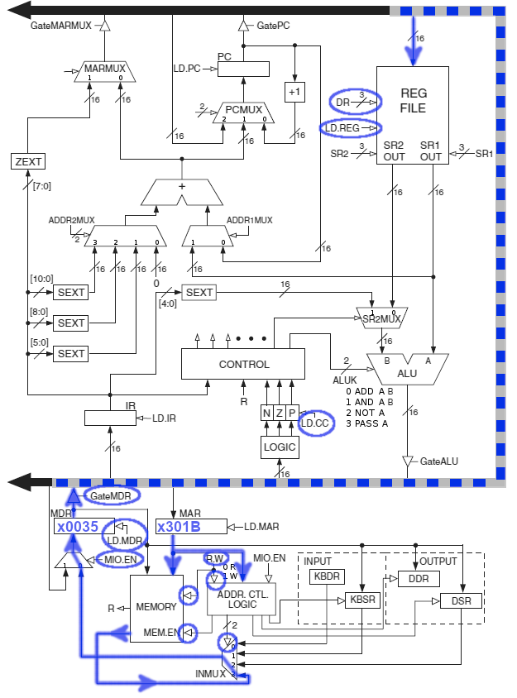
Example instruction LDI R2, #AF Execute Step 4 & 5 State 25 & 27
Step 4
MDR <- MEM[MAR]
Step 5
DR <- MDR

Slide 43
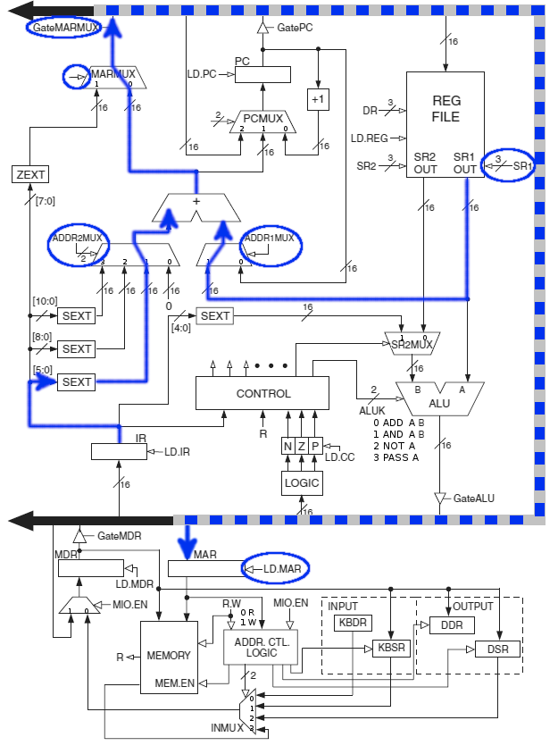
The LDR data path Execute step 1 State 6
LDR R2, R6, #13
0110 010 110 001101
Steps exactly the
same as LD except
Address is Base
Register + Offset
instead of
PC + PCOffset

Slide 44
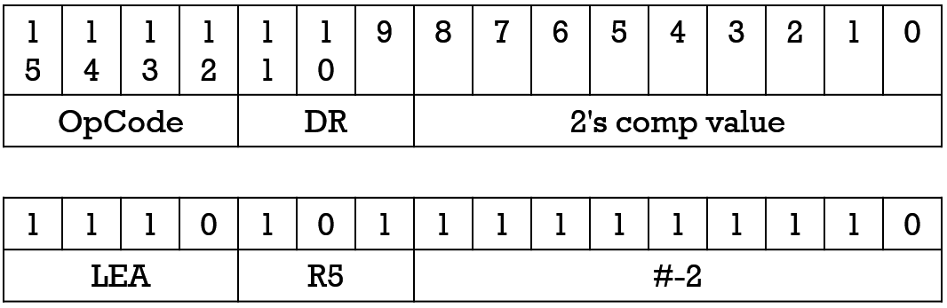
LEA and Immediate Mode
Load Effective Address (LEA) – Puts an address into a register instead of data.
Immediate because it doesn't access memory.
Add 8-bit 2's complement immediate (part of the instruction) data to PC and store in register.

Slide 45
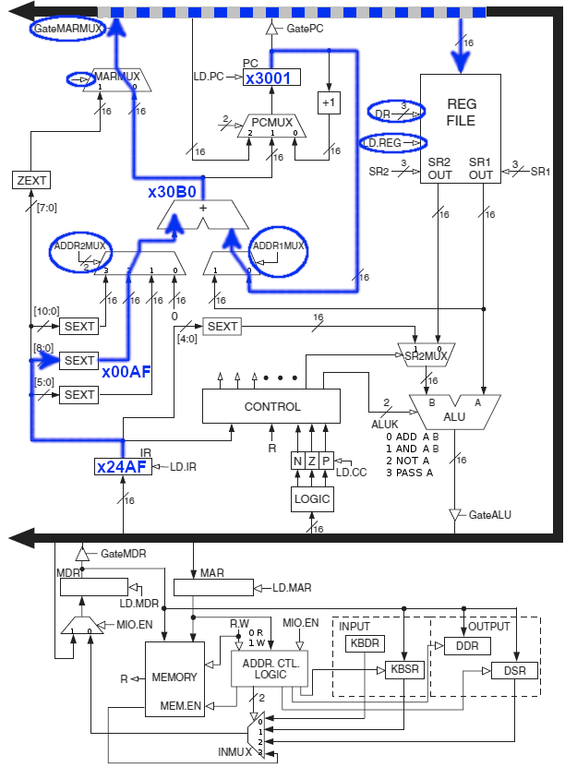
LEA hardware path LEA R2, AF State 14
R2<-PC + IR[8:0]

Slide 46
Addressing Modes Summary
Immediate – Data in instruction.
Register – Data is in register.
PC-Relative – Add immediate value to PC to get address of data.
Indirect – PC-Relative gives address of the address of the data and NOT the data directly.
Base + offset – Immediate value is added to an address from a register.

Slide 47
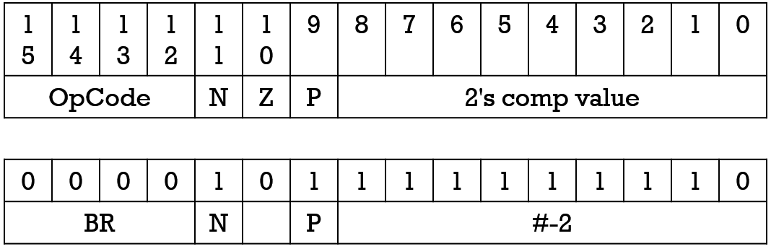
Branching
Branch (BR) – Changes execution order if conditions are met.
Detects Negative, Positive, and Zero
Works in conjunction with one of the following instructions.
ADD, AND, NOT, LD, LDI, LDR, LEA
If one of the above instructions results in a negative, positive, or zero value being written to a register, the appropriate flag (N, P, Z) will be set.

Slide 48
Jumping Around
JSR – Jump to Subroutine or Jump Save Return.
Return address (PC) saved in R7.
11-Bit PC relative addressing.
JSRR – Jump to Subroutine
Base register addressing.
JMP – Jump without saving return.
Base register addressing.
RET – Special form of JMP
Base register is always register R7.
BRNZP – Unconditional branch
9-Bit PC relative addressing.

Slide 49
Base Register with 0 for offset
There are several instructions which need a base register without an offset
JMP, JSRR, RET
There are TWO paths through the LC3 for these instructions.
Unfortunately, the actual implementation doesn't use one or the other. It uses both rather haphazardly.
I assume there were to be updates that never got finished.
The next slide shows both paths.
Questions on the exam could use either, so pay attention to the way the question is asked.

Slide 50
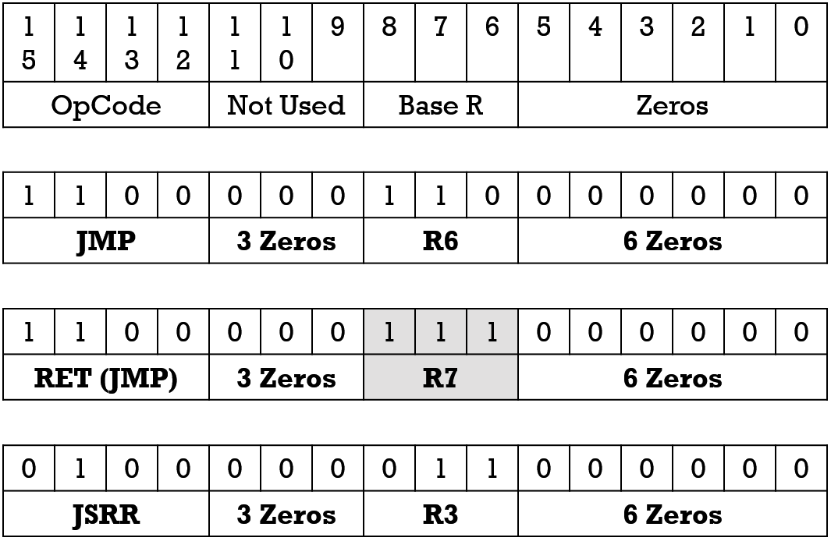
JMP, RET, JSRR – Base Register With No Index
These three instructions alter the flow of program execution.
They jump to code elsewhere in memory and therefore modify the PC.
They all use a register with no/zero index to determine the address.

Slide 51
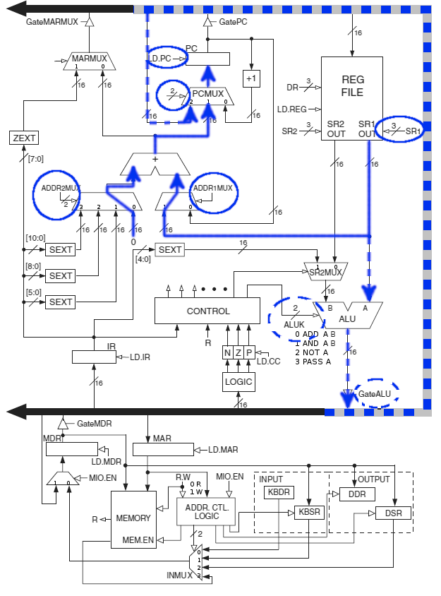
Base register with 0 for offset data path
Either of these paths could
Get a base register into the PC.
JMP, JSRR, RET
Note the ALUK input must be
selected to pass A.
Note the ADDR2MUX must be
Selected to the ZERO input.

Slide 52
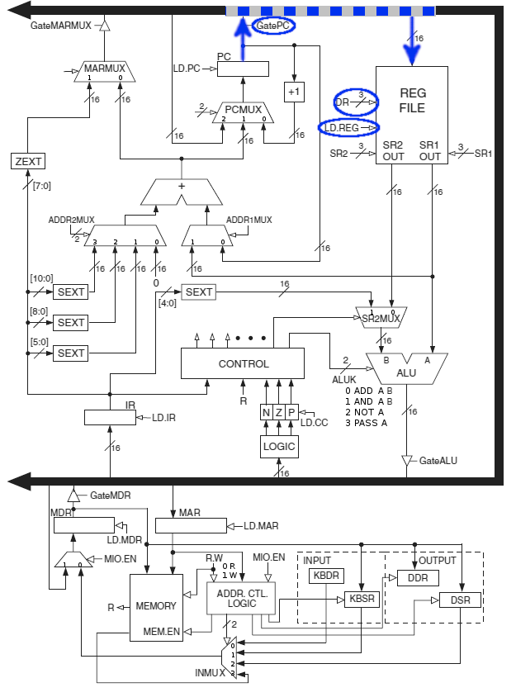
JSR - JSRR Step 1 State 4
Save the PC to R7
R7<-PC
(For JSRR second step see

Slide 53
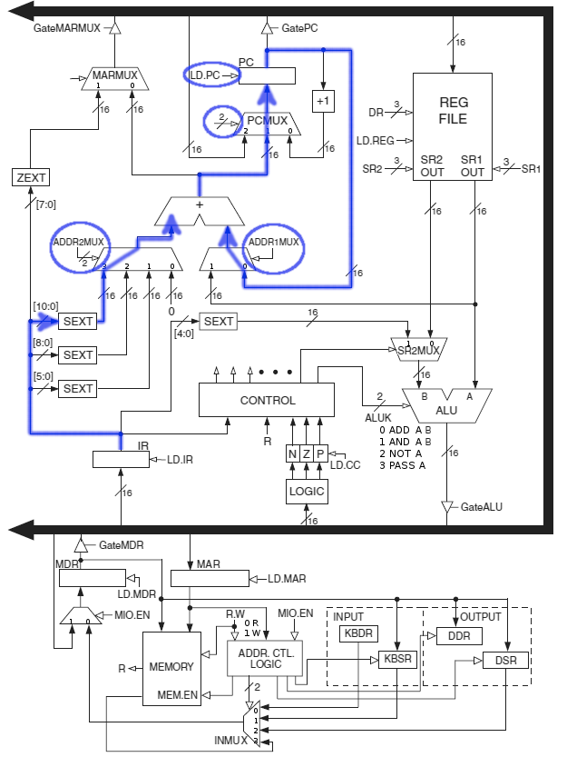
JSR Step 2 State 21
PC<-PC+PCOffset 11

Slide 54
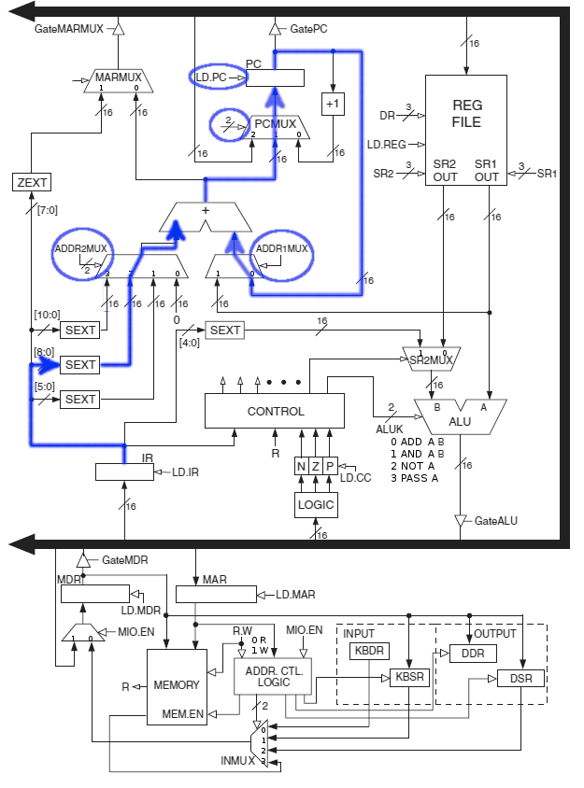
Branch Step 2 State 22
Branch step 1 state 0
Check if branch is required.
Go directly to state 18
Branch step 2 state 22
PC<-PC+Offest9

Slide 55
TRAP
GETC - Get a character from keyboard (TRAP x20).
No prompt is printed.
Execution stops and waits for a key to be pressed.
Store the ASCII code in R0.
OUT - Send a single character to output (TRAPx21).
ASCII character must be stored in R0.
PUTS - Print null terminated string to the output (TRAP x22).
ADDRESS of string must be stored in R0.
IN - Get character from keyboard (TRAP x23)
Print prompt "Input a character>"
Stop and wait for a key to be pressed
Store the ASCII code in R0.
Prints the character to the display.
PUTSP – Print null terminated string to the output (TRAP x24)
Same as PUTS but assumes two characters per word.
Address of string must be stored in R0.
HALT – Stop execution of the processor (TRAP x25).

Slide 56
Opcode Summary (duplicate)
Add - ADD value in a register to a value in a register. Store result in a register.
Add - ADD value in a register to a number. Store result in a register.
And - Bitwise AND value in a register to a value in a register. Store result in a register.
And - Bitwise AND value in a register to a number. Store result in a register.
Not – Invert all of the bits in a register and store the result in a register.
BR, BRNZP – Conditional branch. Like if statement.
LD, LDR, LDI – Load register with a value from memory
ST, STR, STI – Store register value somewhere in memory.
LEA – Load an address into a register and not the data.
JMP – Jump execution to some other place in memory.
JSR, JSRR – Jump to a subroutine similar to a function or method.
RET – Return from the subroutine
RTI – Return from interrupt, restores process information.
TRAP – System call. Like an operating system. Handles input and output.

Slide 57
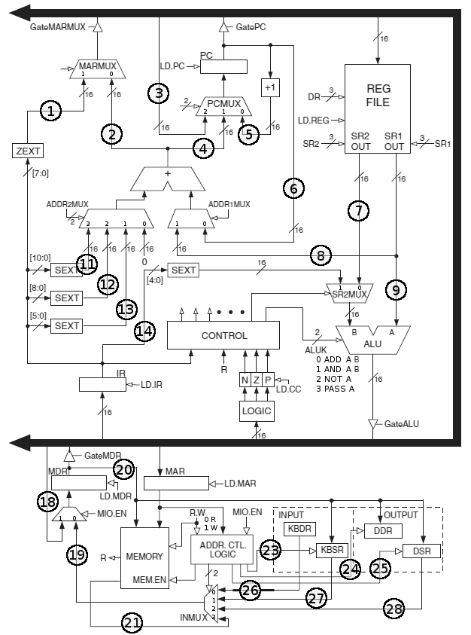
LC3 Questions
Which LC3 instructions during the execution phase use the line labeled 1? 2? 3? Etc…
Which LC3 instructions during the execution phase would require a 0 on MARMUX? 1?
Which LC3 instructions during the execution phase would require a 0 on ADDR1MUX? 1?
Which LC3 instructions during the execution phase would require a 0 on ADDR2MUX? 1? 2? 3?
Which LC3 instructions during the execution phase would require a 0 on PCMUX? 1? 2?
Which LC3 instructions during the execution phase would require a 0 on SR2MUX? 1?
Which LC3 instructions during the execution phase would need a 1 on LD.MAR? LD.MDR? LD.IR? LD.REG? LD.PC? LD.CC?
Which LC3 instructions during the execution phase would require a 1 on GateMARMUX? GatePC? GateALU? GateMDR?

